Slide 1
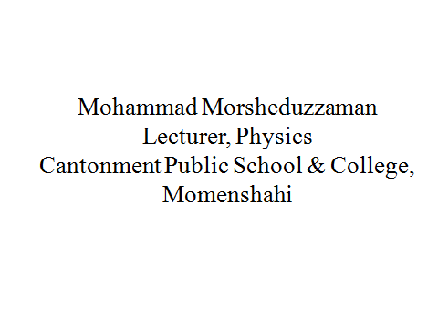

Slide 2
Work, Energy and Power
Variable force
Variable Force: When force depend on displacement
Example: Gravitation, Gravity, Spring force, Magnetic force and Electrostatic force etc.

Slide 3
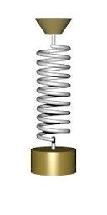
Work, Energy and Power
Spring force
F_{s}
x
Spring Force,
K= Spring constant

Slide 4
Work, Energy and Power
Work by a variable force
F
F₂
F₁
x
x_{i}
x_{f}
Total Work done,

Slide 5
Work, Energy and Power
Work by a variable force

Slide 6
Work, Energy and Power
Work by a variable force

